Slide 1
Software Requirements Engineering
By
Abid Ali
BS Software Engineering
5th
Lecture #5

Slide 2
Agenda
Requirements development process framework
Good practices: Requirements elicitation . . . . . .
Good practices: Requirements analysis . . . . . . .
Good practices: Requirements specification . . . .
Good practices: Requirements validation . . . . . .

Slide 3
Best Practices
Table 3-1 lists more than 50 practices, grouped into 7 categories, that can help all development teams do a better job on their requirements activities.

Slide 4
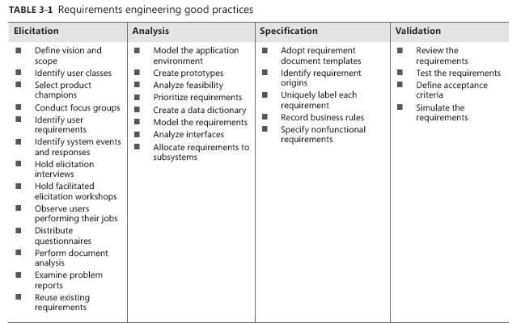

Slide 5
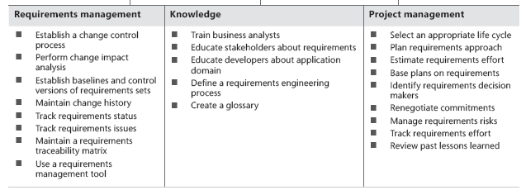

Slide 6
A Requirements Development Process Framework
In practice, the requirements engineering activities are interlinked, incremental, and iterative, as shown in Figure 3-1.
“Progressive refinement of detail” is a key operating phrase for requirements development, moving from initial concepts of what is needed toward further precision of understanding and expression

Slide 7
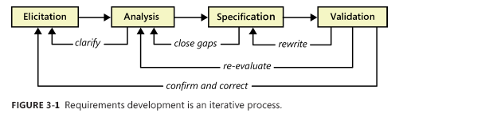
Cont..

Slide 8
Requirements Development Process
The business need or market opportunity is the predecessor for the process shown in Figure 3-2.
These steps are generally performed approximately in numerical sequence, but the process is not strictly sequential.
The first seven steps are typically performed once early in the project (although the team will need to revisit all of these activities periodically).
The remaining steps are performed for each release or development iteration.
Many of these activities can be performed iteratively, and they can be interwoven. For instance, you can perform steps 8, 9, and 10 in small chunks, performing a review (step 12) after each iteration.

Slide 9
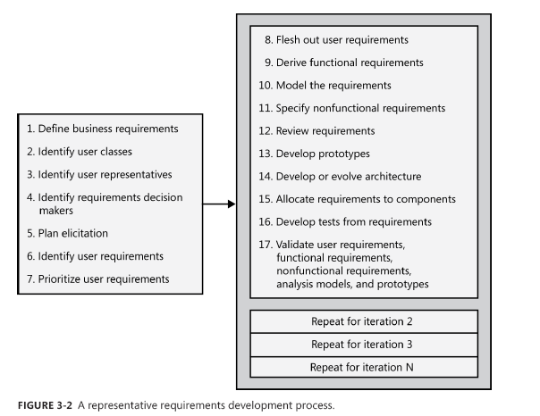
Cont..

Slide 10
Cont..
The fifth sub-discipline of requirements engineering is requirements management.
Requirements management encompasses practices that help you deal with requirements after you have them in hand.
These practices include version control and baselining, change control, tracking requirements status, and tracing requirements to other system elements.
Requirements management will take place throughout the project’s duration at a low level of intensity.

Slide 11
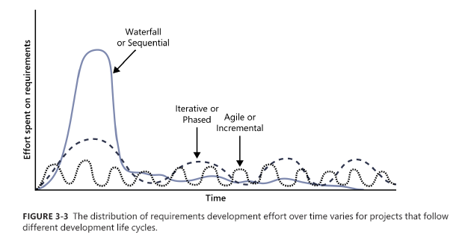
Cont..

Slide 12
Good practices: Requirements elicitation
Define product vision and project scope :
The vision and scope document contains the product’s business requirements.
The vision statement gives all stakeholders a common understanding of the product’s outcome.
The scope defines the boundary between what’s in and what’s out for a specific release or iteration.
Together, the vision and scope provide a reference against which to evaluate proposed requirements.
The vision should remain relatively stable throughout the project, but each planned release or iteration needs its own scope statement .

Slide 13
Cont..
Identify user classes and their characteristics :
To avoid overlooking the needs of any user community, identify the various groups of users for your product.
They might differ in frequency of use, features used, privilege levels, or experience.
Describe aspects of their job tasks, attitudes, location, or personal characteristics that might influence product design.
Create user personas, descriptions of imaginary people who will represent particular user classes.

Slide 14
Cont..
Select a product champion for each user class:
Identify an individual who can accurately serve as the literal voice of the customer for each user class.
The product champion presents the needs of the user class and makes decisions on its behalf.
This is easiest for internal information systems development, where your users are fellow employees.
For commercial product development, build on your current relationships with major customers or beta test sites to locate appropriate product champions.

Slide 15
Cont..
Conduct focus groups with typical users:
Convene groups of representative users of your previous products or of similar products.
Collect their input on both functionality and quality characteristics for the product under development.
Focus groups are particularly valuable for commercial product development, for which you might have a large and diverse customer base.
Unlike product champions, focus groups generally do not have decision-making authority .

Slide 16
Cont..
Work with user representatives to identify user requirements:
Explore with your user representatives the tasks they need to accomplish with the software and the value they’re trying to achieve.
User requirements can be expressed in the form of use cases, user stories, or scenarios.
Discuss the interactions between the users and the system that will allow them to complete each task

Slide 17
Cont..
Identify system events and responses:
List the external events that the system can experience and its expected response to each event.
There are three classes of external events. Signal events are control signals or data received from external hardware devices.
Temporal, or time-based, events trigger a response, such as an external data feed that your system generates at the same time every night.
Business events trigger use cases in business applications

Slide 18
Cont..
Hold elicitation interviews:
Interviews can be performed one-on-one or with a small group of stakeholders.
They are an effective way to elicit requirements without taking too much stakeholder time because you meet with people to discuss only the specific requirements that are important to them.
Interviews are helpful to separately elicit requirements from people in preparation for workshops where those people come together to resolve any conflicts

Slide 19
Cont..
Hold facilitated elicitation workshops:
Facilitated requirements-elicitation workshops that permit collaboration between analysts and customers are a powerful way to explore user needs and to draft requirements documents (Gottesdiener 2002).
Such workshops are sometimes called Joint Application Design, or JAD, sessions (Wood and Silver 1995

Slide 20
Cont..
Observe users performing their jobs:
Watching users perform their business tasks establishes a context for their potential use of a new application.
Simple process flow diagrams can depict the steps and decisions involved and show how different user groups interact.
Documenting the business process flow will help you identify requirements for a solution that’s intended to support that process.

Slide 21
Cont..
Distribute questionnaires:
Questionnaires are a way to survey large groups of users to determine what they need.
Questionnaires are useful with any large user population but are particularly helpful with distributed groups.
If questions are well written, questionnaires can help you quickly determine analytical information about needs

Slide 22
Cont..
Perform document analysis
Existing documentation can help reveal how systems currently work or what they are supposed to do.
Documentation includes any written information about current systems, business processes, requirements specifications, competitor research, and COTS (commercial off-the-shelf) package user manuals.
Reviewing and analyzing the documents can help identify functionality that needs to remain, functionality that isn’t used, how people do their jobs currently, what competitors offer, and what vendors say their software should do.

Slide 23
Cont..
Examine problem reports of current systems
for requirement ideas:
Problem reports and enhancement requests from users provide a rich source of ideas for capabilities to include in a later release or in a new product.
Help desk and support staff can provide valuable input into the requirements for future development work.

Slide 24
Cont..
Reuse existing requirements:
If customers request functionality similar to that already present in an existing product, see whether the requirements (and the customers!) are flexible enough to permit reusing or adapting the existing software components.
Projects often can reuse those requirements that comply with an organization’s business rules, such as security requirements, and requirements that conform to government regulations, such as accessibility requirements.
Other good candidates for reuse include glossaries, data models and definitions, stakeholder profiles, user class descriptions, and personas.

Slide 25
Good Practices: Requirements Analysis
Requirements analysis involves refining the requirements to ensure that all stakeholders understand them and scrutinizing them for errors, omissions, and other deficiencies.
Analysis includes decomposing high-level requirements into appropriate levels of detail, building prototypes, evaluating feasibility, and negotiating priorities.
The goal is to develop requirements of sufficient quality and precision that managers can construct realistic project estimates and technical staff can proceed with design, construction, and testing

Slide 26
Cont..
Model the application environment:
The context diagram is a simple analysis model that shows how the new system fits into its environment.
It defines the boundaries and interfaces between the system being developed and external entities, such as users, hardware devices, and other systems.
An ecosystem map shows the various systems in the solution space that interact with each other and the nature of their interconnections

Slide 27
Cont..
Create user interface and technical prototypes:
When developers or users aren’t certain about the requirements, construct a prototype—a partial, possible, or preliminary implementation—to make the concepts and possibilities more tangible.
Prototypes allow developers and users to achieve a mutual understanding of the problem being solved, as well as helping to validate requirements

Slide 28
Cont..
Analyze Requirement Feasibility:
The BA should work with developers to evaluate the feasibility of implementing each requirement at acceptable cost and performance in the intended operating environment.
This allows stakeholders to understand the risks associated with implementing each requirement, including conflicts and dependencies with other requirements, dependencies on external factors, and technical obstacles.
Requirements that are technically infeasible or overly expensive to implement can perhaps be simplified and still contribute to achieving the project’s business

Slide 29
Cont..
Prioritize the requirements:
It’s important to prioritize requirements to ensure that the team implements the highest value or most timely functionality first.
Apply an analytical approach to determine the relative implementation priority of product features, use cases, user stories, or functional requirements.
Based on priority, determine which release or increment will contain each feature or set of requirements.
Adjust priorities throughout the project as new requirements are proposed and as customer needs, market conditions, and business goals evolve.

Slide 30
Cont..
Create a data dictionary:
Definitions of the data items and structures associated with the system reside in the data dictionary.
This enables everyone working on the project to use consistent data definitions.
As requirements are developed, the data dictionary should define data items from the problem domain to facilitate communication between the customers and the development team.

Slide 31
Cont..
Model the requirements
An analysis model is a diagram that depicts requirements visually, in contrast to the textual representation of a list of functional requirements.
Models can reveal incorrect, inconsistent, missing, and superfluous requirements. Such models include data flow diagrams, entity-relationship diagrams, state-transition diagrams, state tables, dialog maps, decision trees, and others

Slide 32
Cont..
Analyze interfaces between your system and the outside world:
All software systems have connections to other parts of the world through external interfaces.
Information systems have user interfaces and often exchange data with other software systems.
Embedded systems involve interconnections between software and hardware components.
Network-connected applications have communication interfaces.
Analyzing these helps make sure that your application will fit smoothly into its environment.

Slide 33
Good practices: Requirements specification
The essence of requirements specification is to document requirements of different types in a consistent, accessible, and reviewable way that is readily understandable by the intended audiences.
You can record the business requirements in a vision and scope document.
User requirements typically are represented in the form of use cases or user stories.
Detailed software functional and nonfunctional requirements are recorded in a software requirements specification (SRS) or an alternative repository, such as a requirements management tool.

Slide 34
Cont..
Adopt requirement document templates:
Adopt standard templates for documenting requirements in your organization, such as the vision and scope document template, the use case template, and the SRS template.
The templates provide a consistent structure for recording various groups of requirements-related information.
Even if you don’t store the requirements in traditional document form, the template will remind you of the various kinds of requirements information to explore and record.

Slide 35
Cont..
Identify requirement origins:
To ensure that all stakeholders know why every requirement is needed, trace each one back to its origin.
This might be a use case or some other customer input, a high-level system requirement, or a business rule.
Recording the stakeholders who are affected by each requirement tells you whom to contact when a change is requested.
Requirement origins can be identified through traceability links or by defining a requirement attribute for this purpose

Slide 36
Cont..
Uniquely label each requirement:
Define a convention for giving each requirement a unique identifying label.
The convention must be robust enough to withstand additions, deletions, and changes made in the requirements over time.
Labeling the requirements permits requirements traceability and the recording of changes made

Slide 37
Cont..
Record Business Rules:
Business rules include corporate policies, government regulations, standards, and computational algorithms.
Document your business rules separately from a project’s requirements because they typically have an existence beyond the scope of a specific project.
That is, treat business rules as an enterprise-level asset, not a project-level asset. Some rules will lead to functional requirements that enforce them, so define traceability links between those requirements and the corresponding rules

Slide 38
Cont..
Specify nonfunctional requirements:
It’s possible to implement a solution that does exactly what it’s supposed to do but does not satisfy the users’ quality expectations.
To avoid that problem, you need to go beyond the functionality discussion to understand the quality characteristics that are important to success.
These characteristics include performance, reliability, usability, modifiability, and many others.
Customer input on the relative importance of these quality attributes lets the developer make appropriate design decisions.
Also, specify external interface requirements, design and implementation constraints, internationalization issues, and other nonfunctional requirements.

Slide 39
Good practices: Requirements validation
Validation ensures that the requirements are correct, demonstrate the desired quality characteristics, and will satisfy customer needs.
Requirements that seem fine when you read them might turn out to have ambiguities and gaps when developers try to work with them.
You must correct these problems if the requirements are to serve as a reliable foundation for design and for final system testing and user acceptance testing

Slide 40
Cont..
Review the requirements
Peer review of requirements, particularly the type of rigorous review called inspection, is one of the highest-value software quality practices available (Wiegers 2002).
Assemble a small team of reviewers who represent different perspectives (such as analyst, customer, developer, and tester), and carefully examine the written requirements, analysis models, and related information for defects.
Informal preliminary reviews during requirements development are also valuable. It’s important to train the team members in how to perform effective requirements reviews and to adopt a review process for your organization

Slide 41
Cont..
Test the requirements :
Tests constitute an alternative view of the requirements. Writing tests requires you to think about how to tell if the expected functionality was correctly implemented.
Derive tests from the user requirements to document the expected behavior of the product under specified conditions.
Walk through the tests with customers to ensure that they reflect user expectations.
Map the tests to the functional requirements to make sure that no requirements have been overlooked and that all have corresponding tests. Use the tests to verify the correctness of analysis models and prototypes.
Agile projects often create acceptance tests in lieu of detailed functional requirements.

